Slide 1
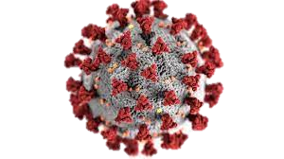
A Study on Covid-19 Vaccines
Vaccines from 3 Manufacturers using Machine Learning Approach

Slide 2
NLP (Text Analysis) – Part I – Sentiment Analysis
Based on Twitter Feeds performed Sentiment Classification

Slide 3
Sentiment Analysis – Step by Step Workflow (Data Processing)
Remove Punctuations & Unreadable Characters
Lemmatizing Texts
Fetch Twitter Data using Twitter API and access tokens using Keywords Corona & Covid from Sep 2021
Import the flagged data into Python environment and convert into document
Remove Common Words
Remove Stop Words
Remove Rare Words
Convert Chat Words to Texts
NULL Hypothesis
The texts do not have any impact on the Vaccine Manufacturers
Clean Texts by removing White Spaces

Slide 4
Sentiment Analysis – Step by Step Workflow (Sentiment Prediction)
Using Pre Trained Model of Vader predict the Sentiment of the Tweets
Removing Words Less than 3 letters
Creating a Word Cloud for the Positive and Negative words
Calculate Words and their Frequency/Counter
Build Word Cloud at a Overall Level and across the three Manufacturers
Sentiment Score | Polarity
Positive | ‘> 0
Neutral | = 0
Negative | ‘< 0

Slide 5
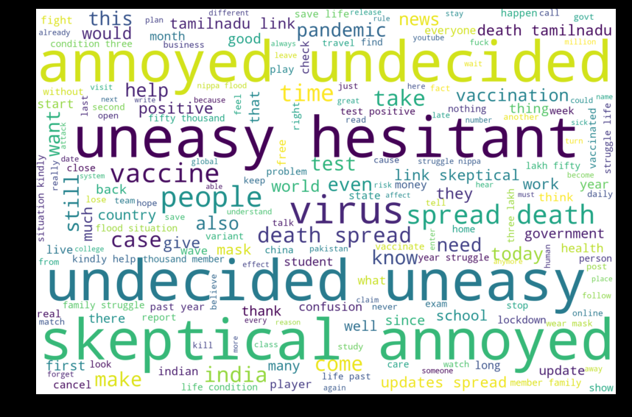
Word Cloud of All Twitter Feeds - Overall

Slide 6
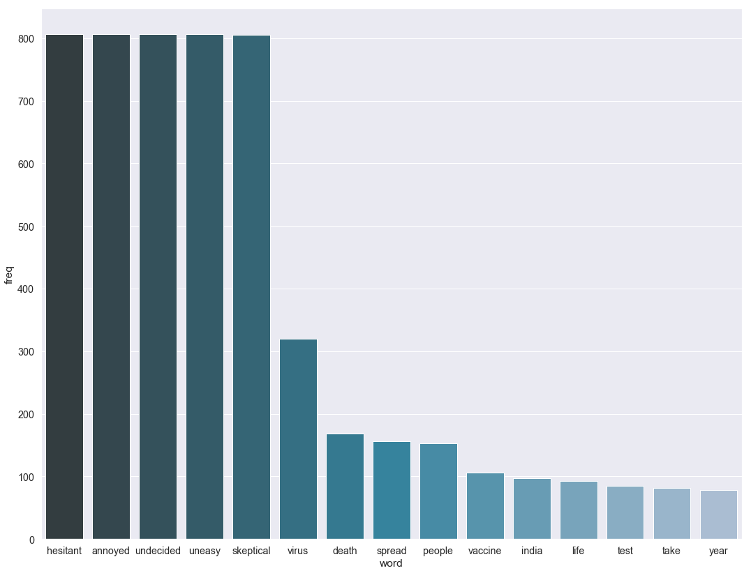
Word Frequency - Overall

Slide 7
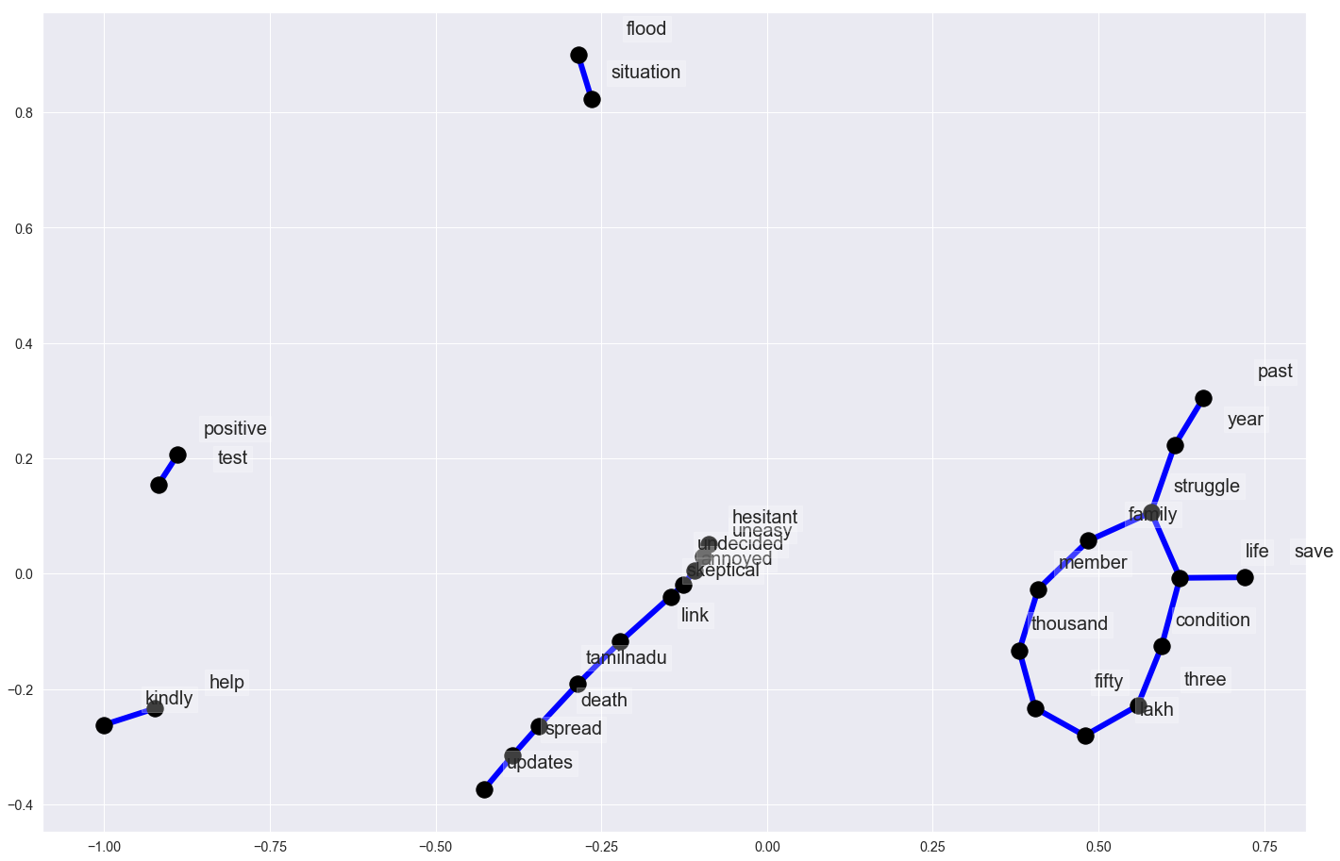
Network Graph of All Twitter Feeds - Overall

Slide 8
NLP Summary – Based on Sentiment Score (Polarity) Distribution
Vaccine Manufacturers | Neutral | Positive | Negative
Janseen | 5 | 2 | 3
Moderna | 158 | 234 | 477
Pfizer | 152 | 240 | 820
Vaccine Manufacturers | Neutral | Positive | Negative
Janseen | 50% | 20% | 30%
Moderna | 18% | 27% | 55%
Pfizer | 13% | 20% | 68%
Janseen has very few Tweets, so it can be ignored. Moderna has a higher Positive Tweets compared to Pfizer

Slide 9
Janseen Vaccine
Based on Twitter Feeds

Slide 10
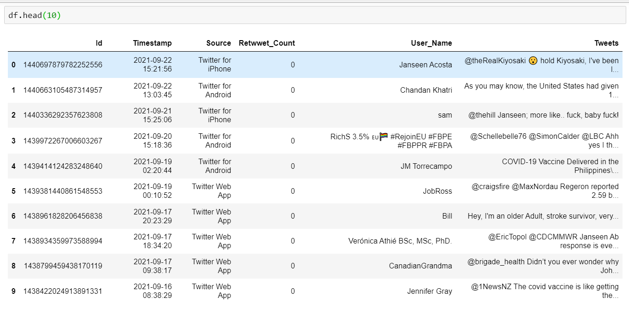
Twitter Data – September 2021 (Token → janseen) | (< 100 Tweets)

Slide 11
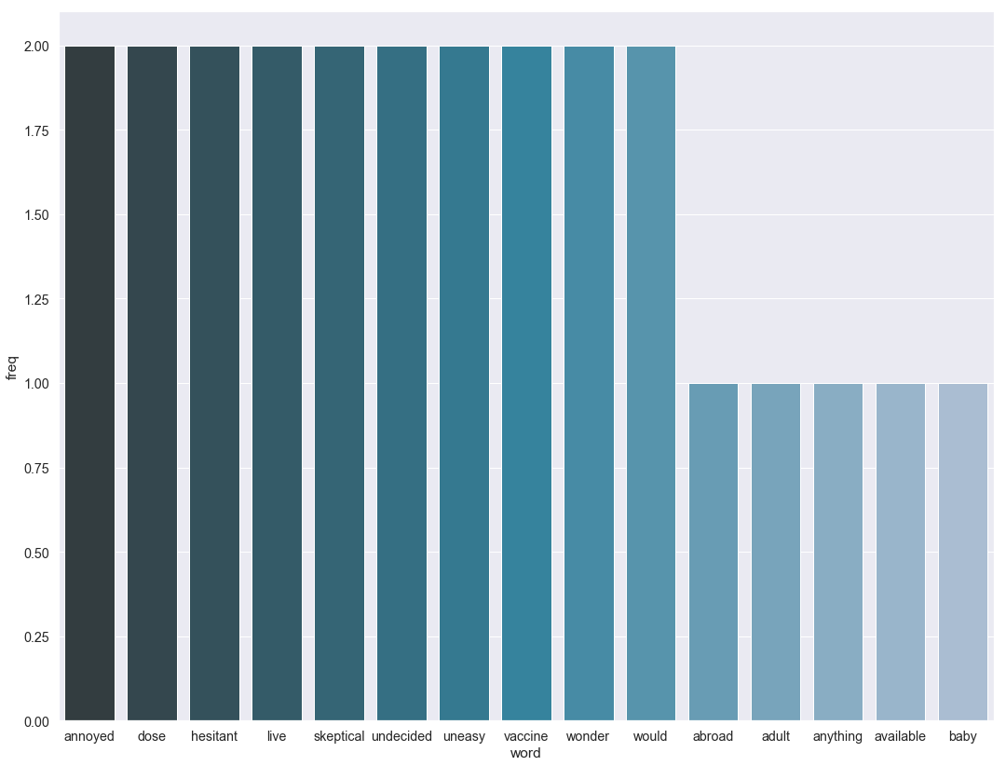
Words Frequency

Slide 12
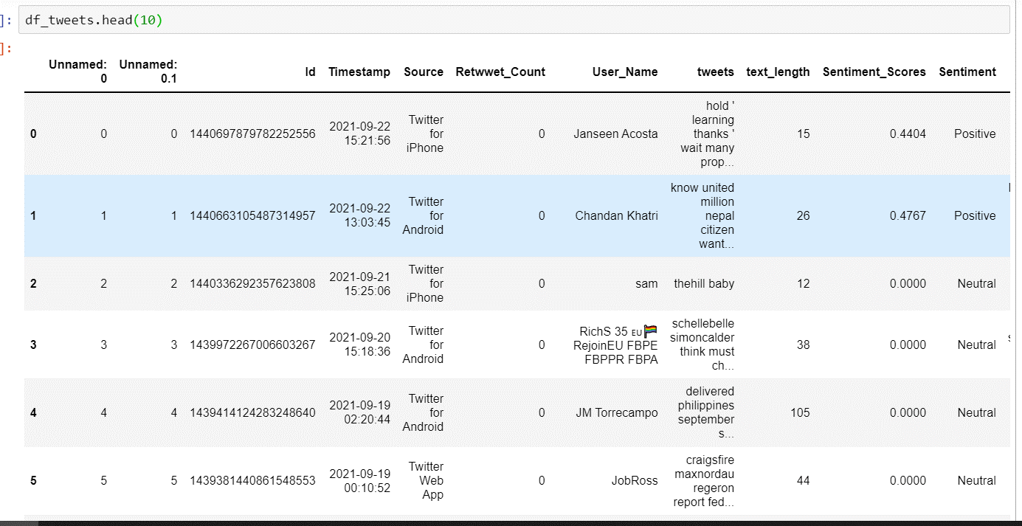
Sentiment Classification using Python

Slide 13
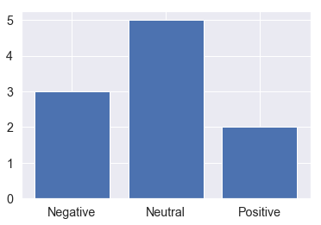
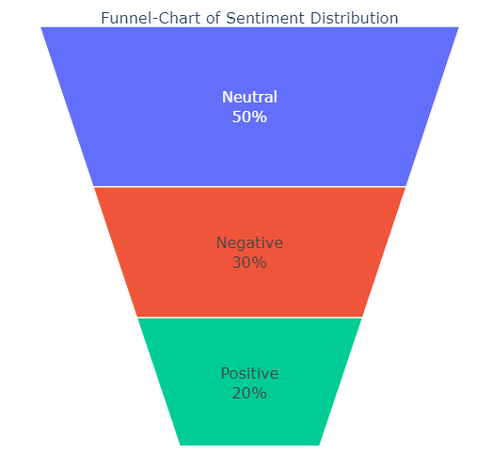
Sentiment Classification

Slide 14
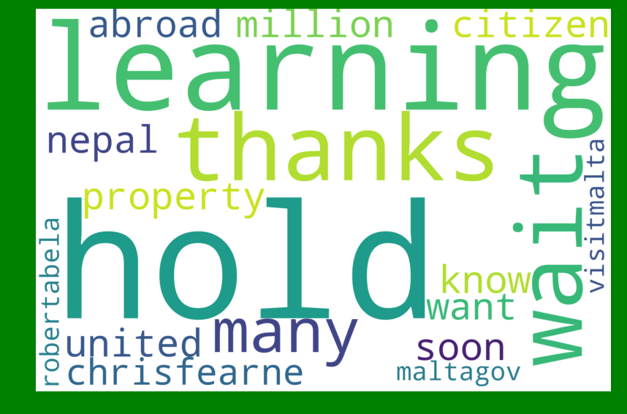
Word Cloud of Positive Twitter Feeds (Sentiment Analysis)

Slide 15
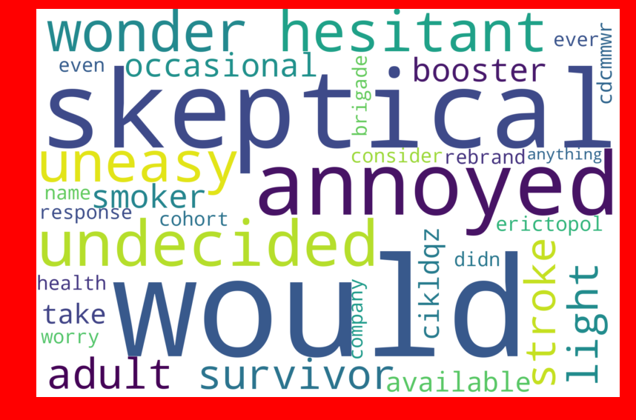
Word Cloud of Negative Twitter Feeds (Sentiment Analysis)

Slide 16
Moderna Vaccine
Based on Twitter Feeds

Slide 17
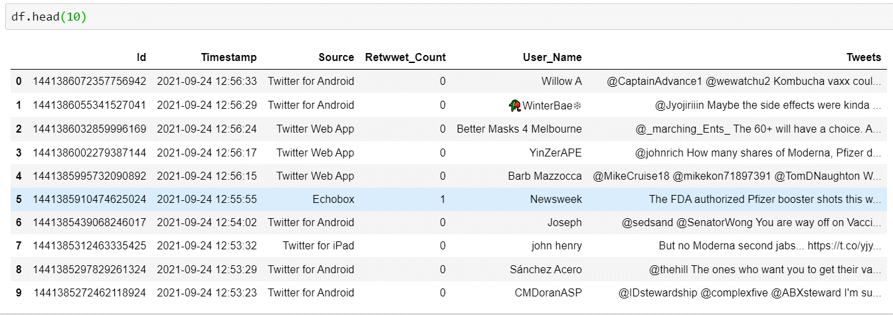
Twitter Data – September 2021 (Token → moderna) | (< 2,000 Tweets)

Slide 18
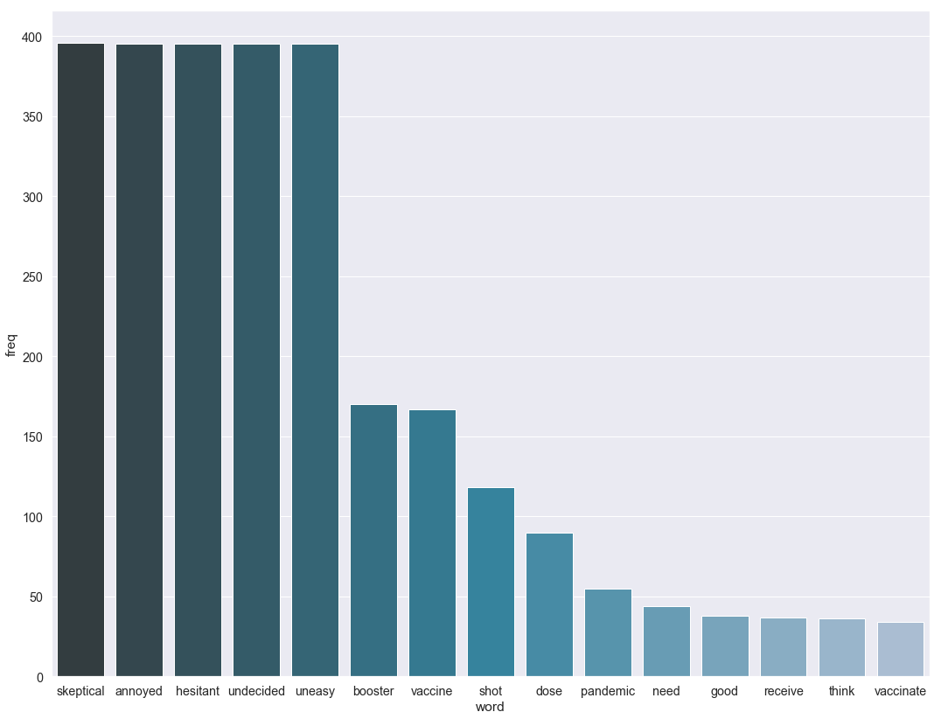
Words Frequency

Slide 19
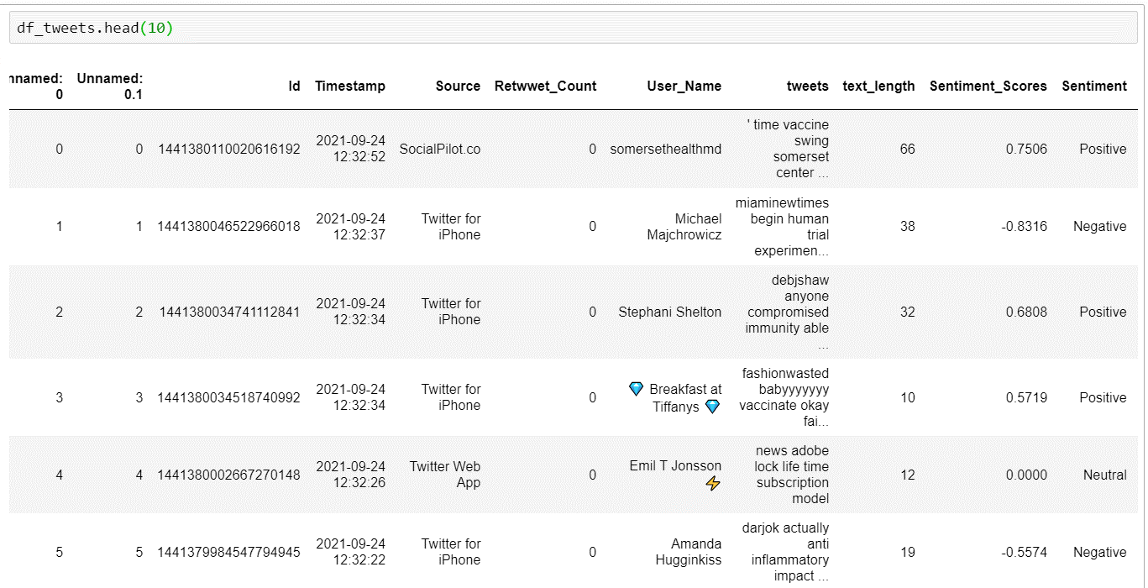
Sentiment Classification using Python

Slide 20
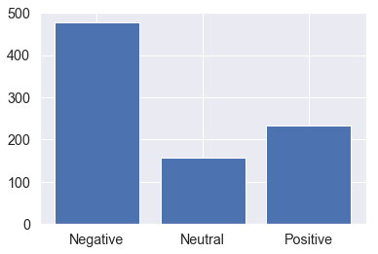
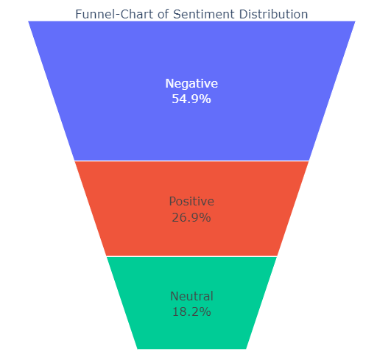
Sentiment Classification

Slide 21
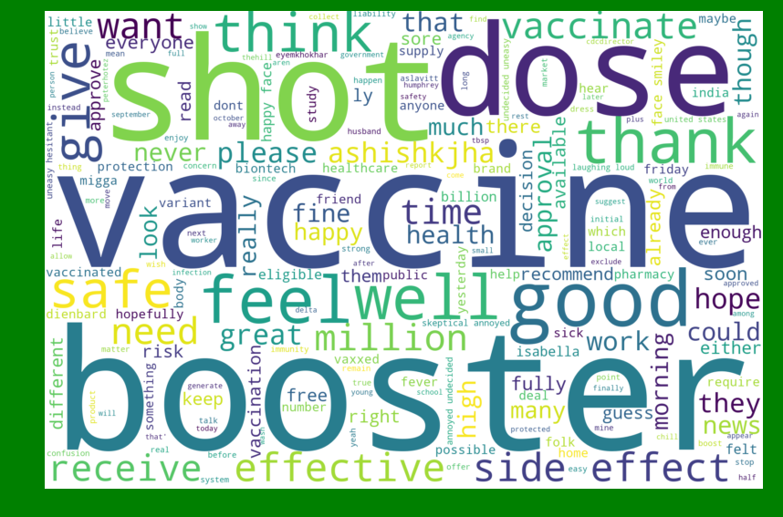
Word Cloud of Positive Twitter Feeds (Sentiment Analysis)

Slide 22
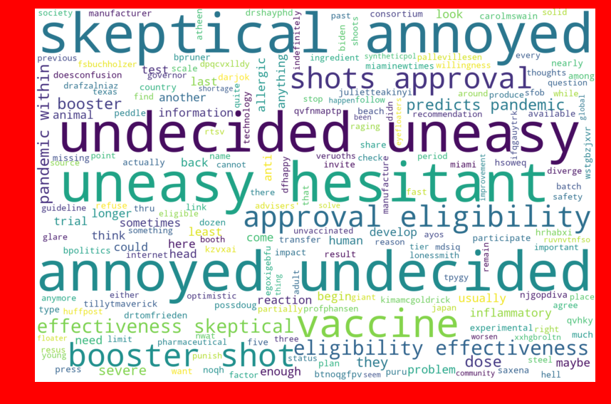
Word Cloud of Negative Twitter Feeds (Sentiment Analysis)

Slide 23
Pfizer/Biontech Vaccine
Based on Twitter Feeds

Slide 24
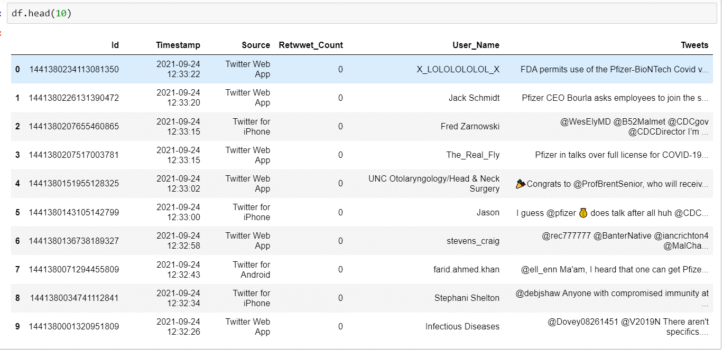
Twitter Data – September 2021 (Token → Pfizer,biontech) | (< 2,000 Tweets)

Slide 25
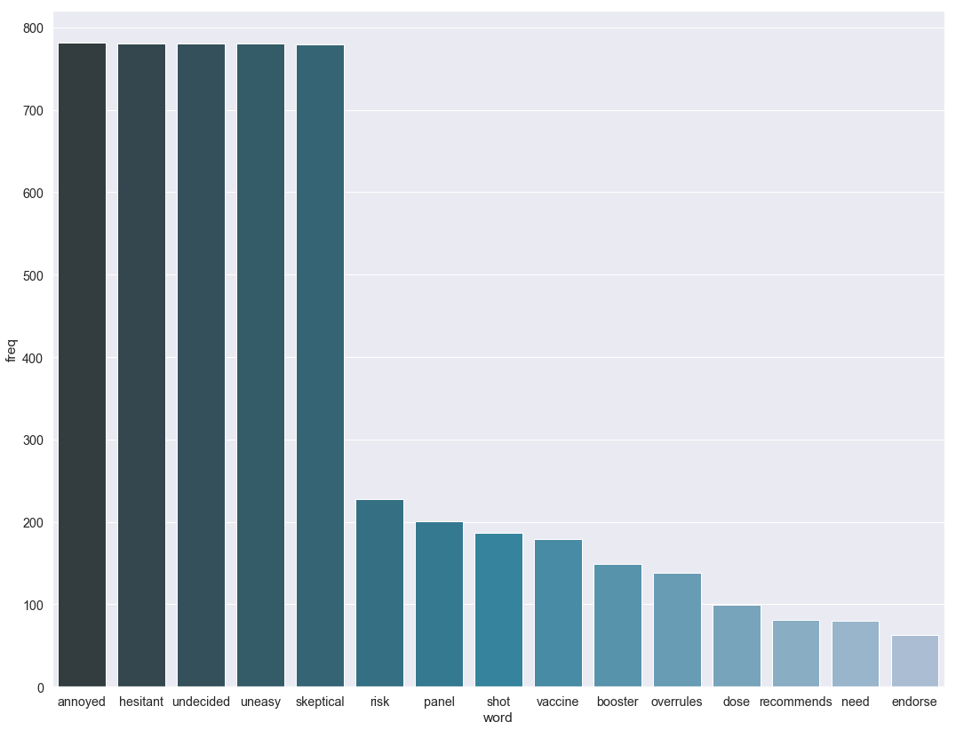
Words Frequency

Slide 26
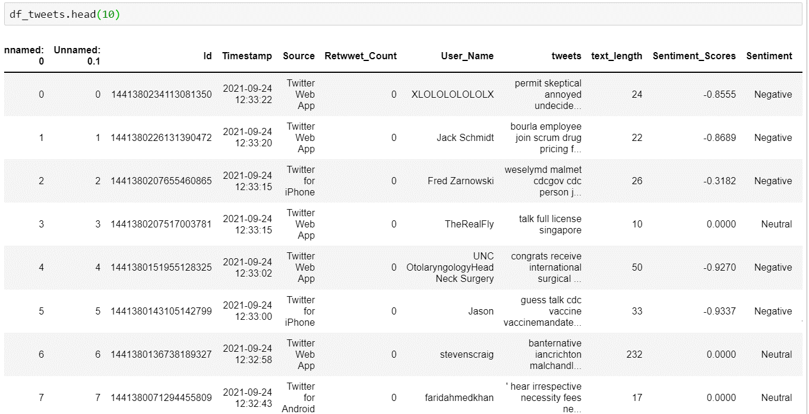
Sentiment Classification using Python

Slide 27
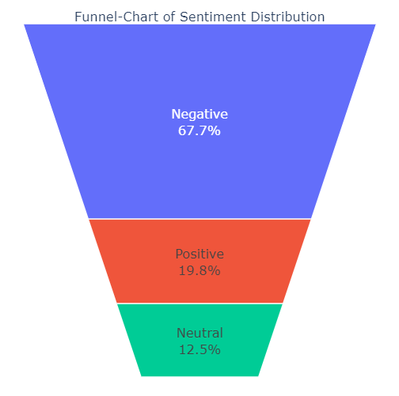
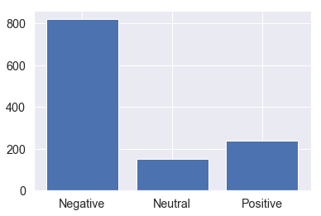
Sentiment Classification

Slide 28
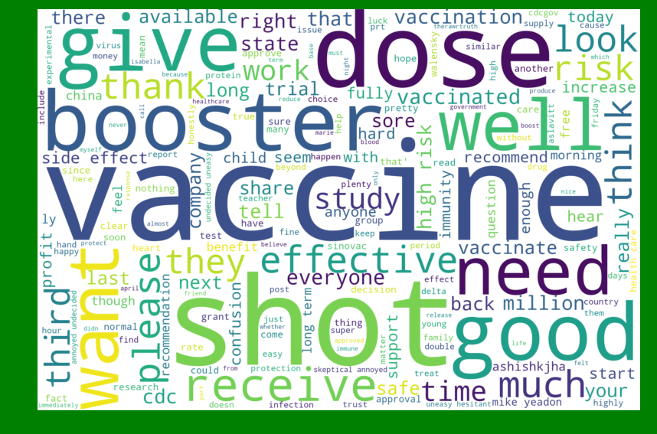
Word Cloud of Positive Twitter Feeds (Sentiment Analysis)

Slide 29
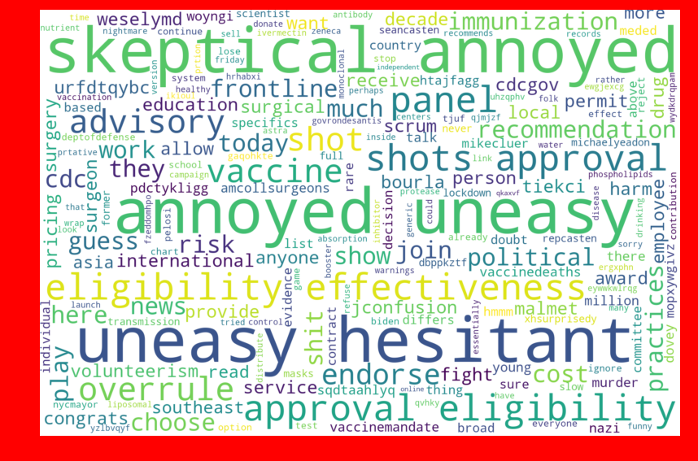
Word Cloud of Negative Twitter Feeds (Sentiment Analysis)

Slide 30
NLP (Text Analysis) – Part II – Word Cloud
Based on Symptoms and After effects of Vaccine (VAERS Data)

Slide 31


Objective
Goal of the Study
Study the adverse effects/symptoms based on the three different vaccines
Out of the 3 Manufacturers identify which of them has higher negative symptoms
Methodology
Collate the VAERS Data into a tabular format
Perform data cleaning and removal of unreadable characters
Find out Words frequency and create Word Cloud based on the three different Vaccines
Find out the Negatives of the Words

Slide 32
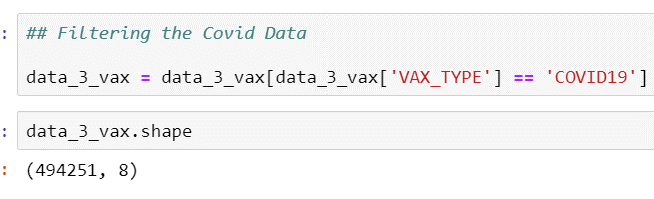
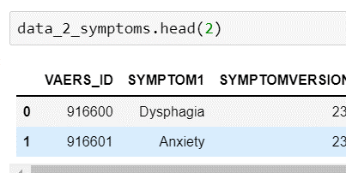
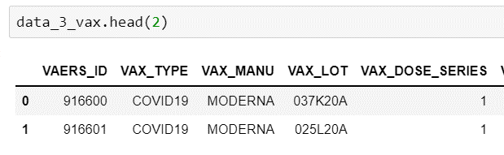
NLP – Textual Analysis of VAERS Data – Step 1
Importing the VAERS Symptoms and VAERS Vaccine Data into the Python environment
Combine the VAERS Symptoms and VAERS Vaccine Data based on VAERS ID
Filtering the Data based on COVID 19 and the 3 Manufacturers (Pfizer, Moderna & Jansees)
NULL Hypothesis
The texts do not have any impact on the Vaccine Manufacturers

Slide 33
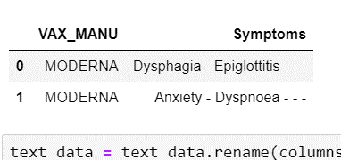
NLP – Textual Analysis of VAERS Data – Step 2
Remove Punctuations & Unreadable Characters
Lemmatizing Texts
Combining all the Symptoms Texts into One Column based on the 3 Manufacturer and removing duplicates (if present)
Remove Common Words
Remove Stop Words
Removing Words Less than 3 letters
Remove Rare Words
Convert Chat Words to Texts
Clean Texts by removing White Spaces

Slide 34
NLP – Textual Analysis of VAERS Data – Step 3
Calculate Words and their Frequency/Counter
Using Pre Trained Model of Vader predict the Sentiment of the Tweets
Creating a Word Cloud for the Neutral words
Build Word Cloud at a Overall Level and across the three Manufacturers
Sentiment Score | Polarity
Negative – Low | Greater than - 0.05
Negative – Medium | Between -0.05 & - 0.5
Negative - High | Less than - 0.5

Slide 35
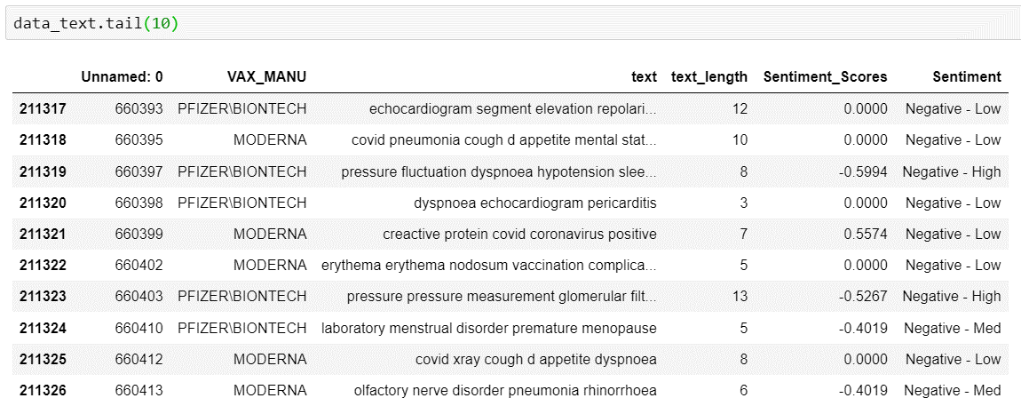
VAERS Data for NLP Analysis

Slide 36
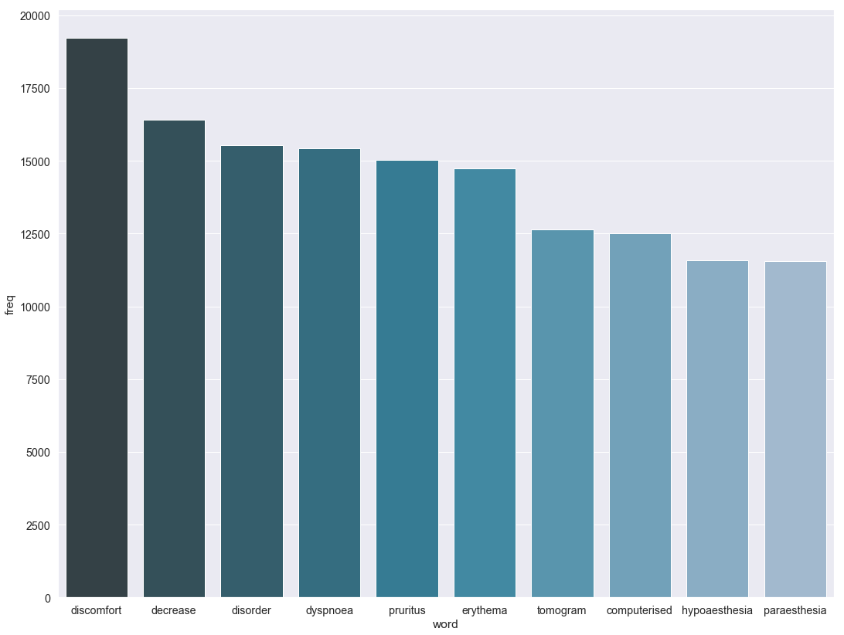
Textual Analysis – Words Frequency (Symptoms) - Overall

Slide 37
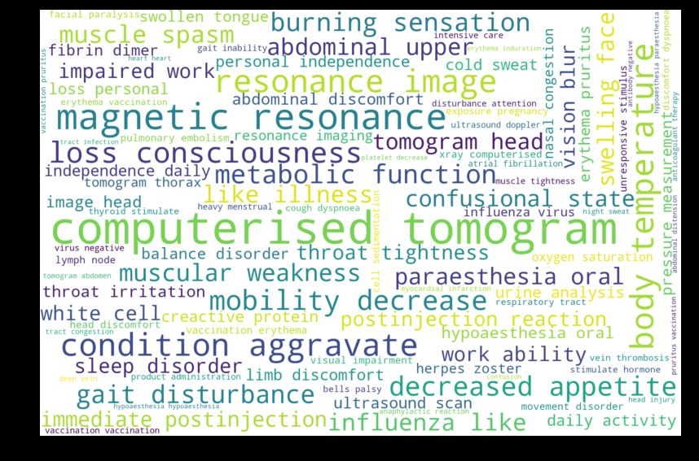
Textual Analysis – Word Cloud - Overall

Slide 38
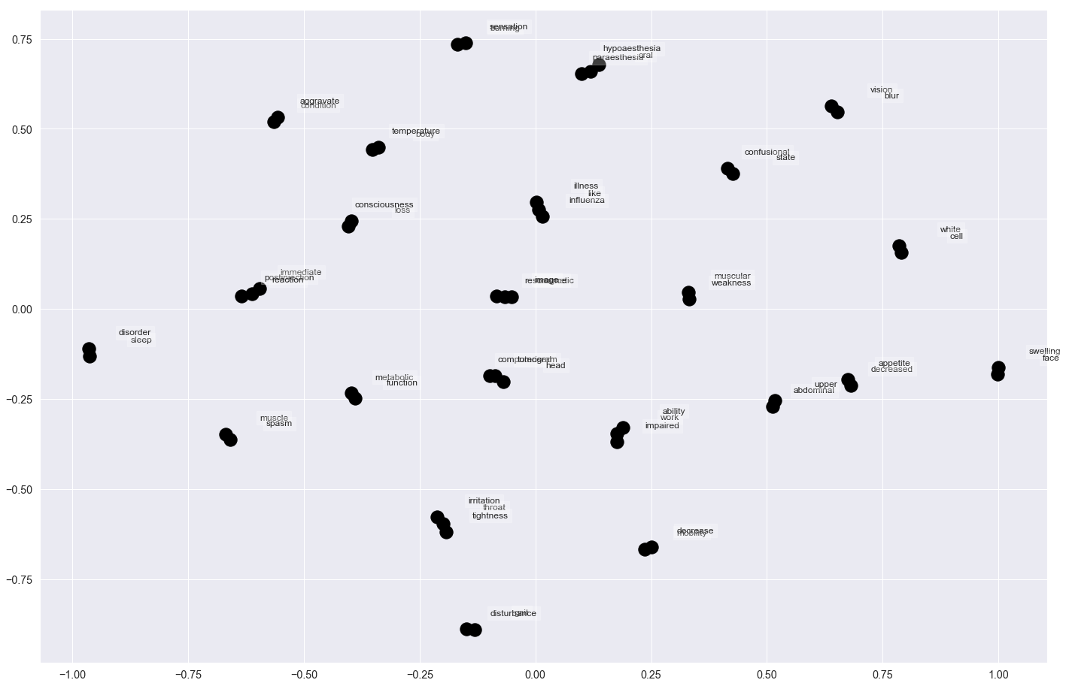
Textual Analysis – Network Graph - Overall

Slide 39
NLP Summary – Based on Sentiment Score (Polarity) Distribution (VAERS Data)
Vaccine Manufacturers | Negative - Low | Negative - Medium | Negative - High
Janseen | 12,766 | 6,433 | 3,508
Moderna | 54,052 | 23,527 | 14,068
Pfizer | 55,042 | 25,186 | 16,745
Vaccine Manufacturers | Negative - Low | Negative - Medium | Negative - High
Janseen | 56% | 28% | 15%
Moderna | 59% | 26% | 15%
Pfizer | 57% | 26% | 17%
Moderna has highest Negative Low based on the Symptoms, we can say that Moderna Vaccines have higher effectiveness

Slide 40
Janseen Vaccine
Based on Symptoms of VAERS Data

Slide 41
Top 20 Symptoms Post Vaccination
Pyrexia | 1151
Vomiting | 507
Product administered to patient of inappropriate age | 471
Syncope | 436
Pain in extremity | 415
Headache | 358
Dizziness | 335
Pain Pyrexia | 327
Rash | 283
Pain | 257
Tremor | 256
Tinnitus | 236
COVID 19 SARS CoV 2 test positive | 219
No adverse event Product administered to patient of inappropriate age | 214
Urticaria | 192
Unevaluable event | 185
Injection site pain | 169
Interchange of vaccine products | 163
Nausea | 148
Expired product administered | 145

Slide 42
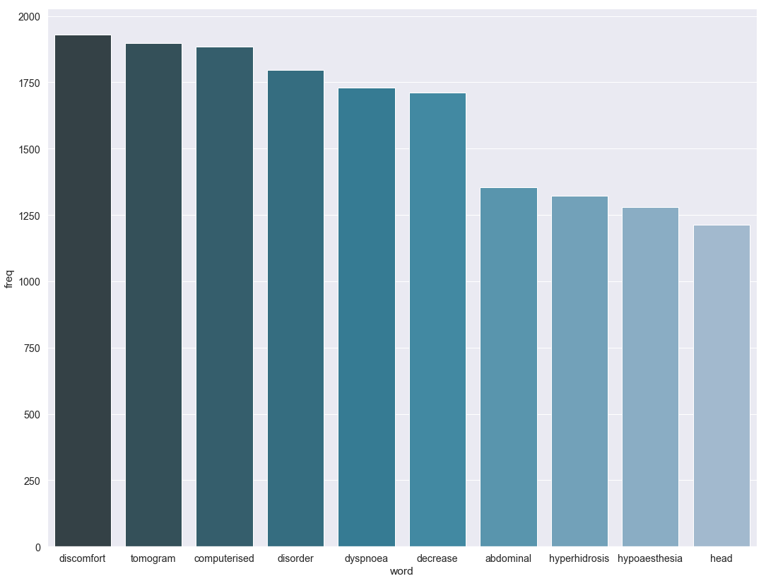
Textual Analysis – Words Frequency (Symptoms)

Slide 43
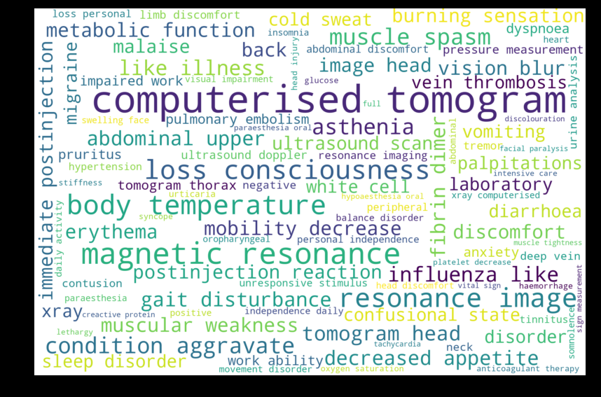
Textual Analysis – Word Cloud

Slide 44
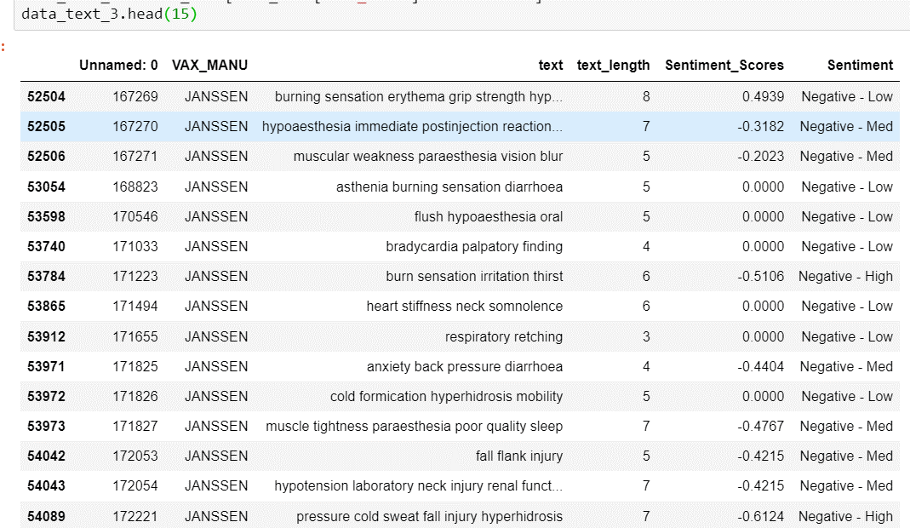
Sentiment Classification using Python

Slide 45
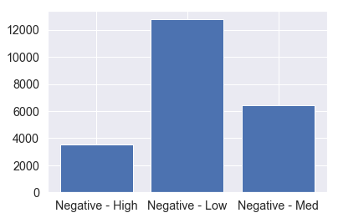
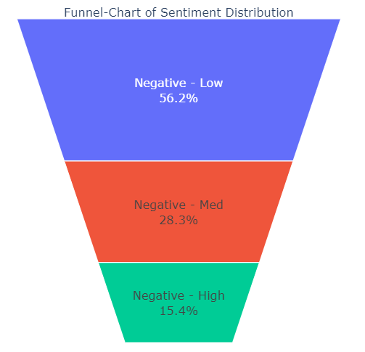
Sentiment Classification

Slide 46
Moderna Vaccine
Based on Symptoms of VAERS Data

Slide 47
Top 20 Symptoms Post Vaccination
Pyrexia | 3814
Product administered to patient of inappropriate age | 3208
Rash | 2009
Unevaluable event | 1785
Vomiting | 1699
Pain in extremity | 1631
Urticaria | 1602
Inappropriate schedule of product administration | 1436
Tinnitus | 1371
Dizziness | 1124
No adverse event Product administered to patient of inappropriate age | 1087
Product storage error | 998
Injection site erythema Injection site pruritus Injection site swelling | 941
Pain | 939
Pain Pyrexia | 917
COVID 19 SARS CoV 2 test positive | 898
Poor quality product administered | 879
Death | 804
Interchange of vaccine products | 781
Pruritus | 735

Slide 48
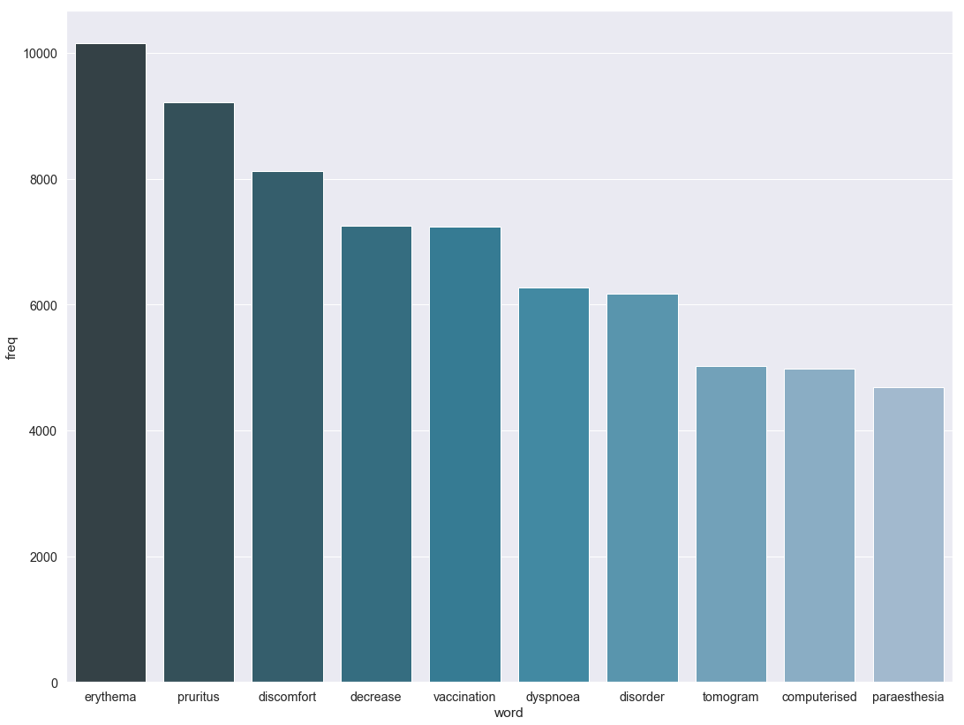
Textual Analysis – Words Frequency (Symptoms)

Slide 49
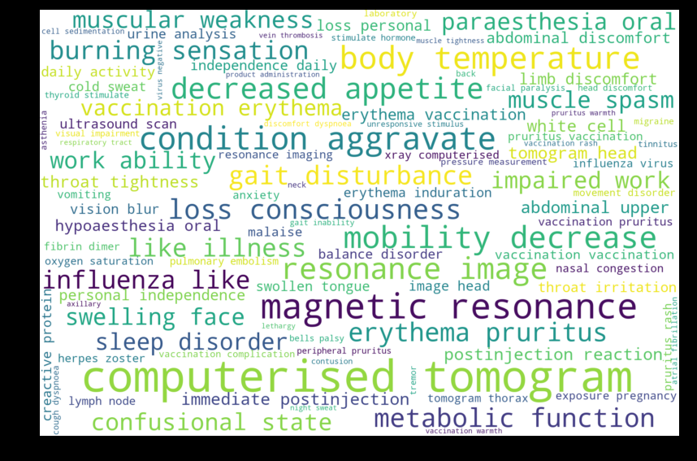
Textual Analysis – Word Cloud

Slide 50
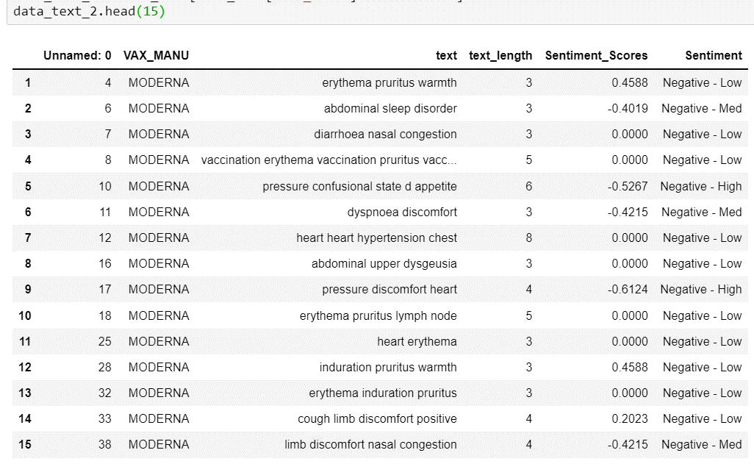
Sentiment Classification using Python

Slide 51
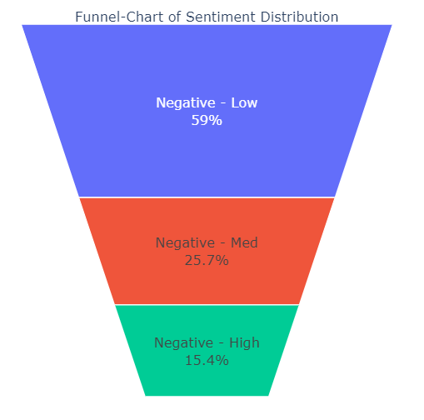
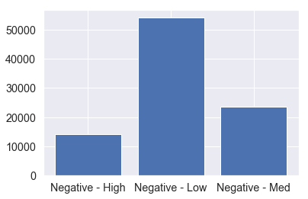
Sentiment Classification

Slide 52
Pfizer Vaccine
Based on Symptoms of VAERS Data

Slide 53
Top 20 Symptoms Post Vaccination
Product storage error | 3037
Pyrexia | 2689
COVID 19 SARS CoV 2 test positive | 2155
Dizziness | 1823
Tinnitus | 1781
Unevaluable event | 1690
Pain in extremity | 1652
Rash | 1611
Urticaria | 1573
Vomiting | 1532
Herpes zoster | 1124
Syncope | 1068
Headache | 1048
Lymphadenopathy | 1032
Product administered to patient of inappropriate age | 1029
Interchange of vaccine products | 961
Inappropriate schedule of product administration | 902
Incorrect dose administered | 862
Product preparation issue | 847
COVID 19 Drug ineffective SARS CoV 2 test | 827

Slide 54
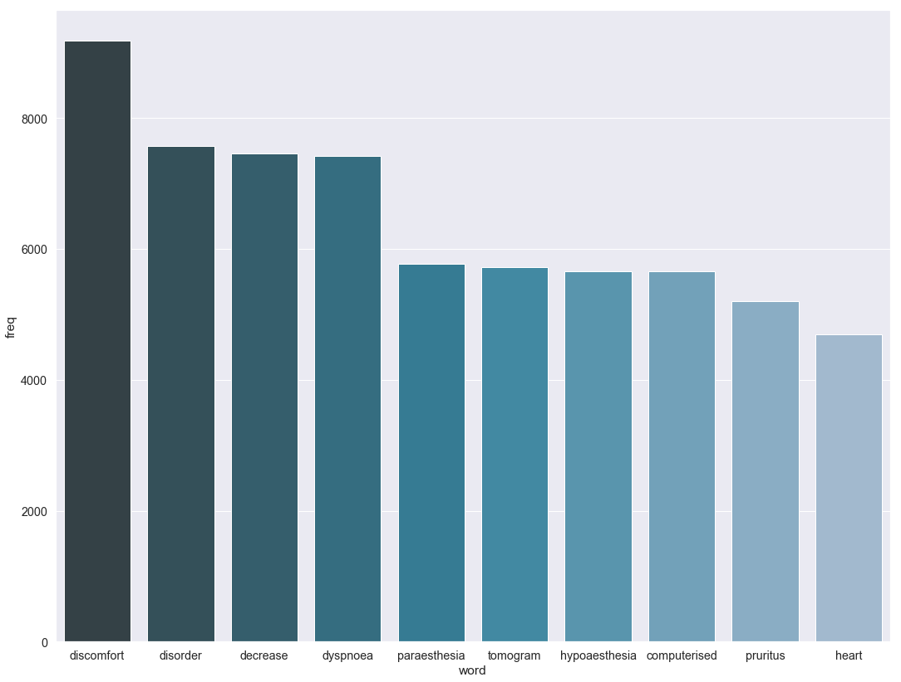
Textual Analysis – Words Frequency (Symptoms)

Slide 55
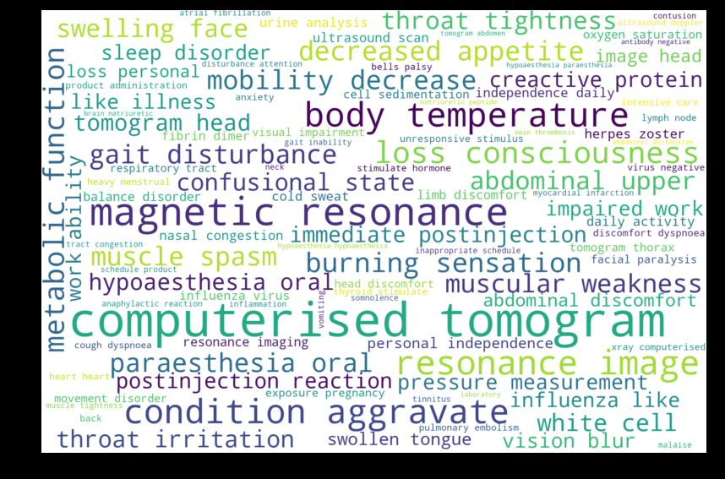
Textual Analysis – Word Cloud

Slide 56
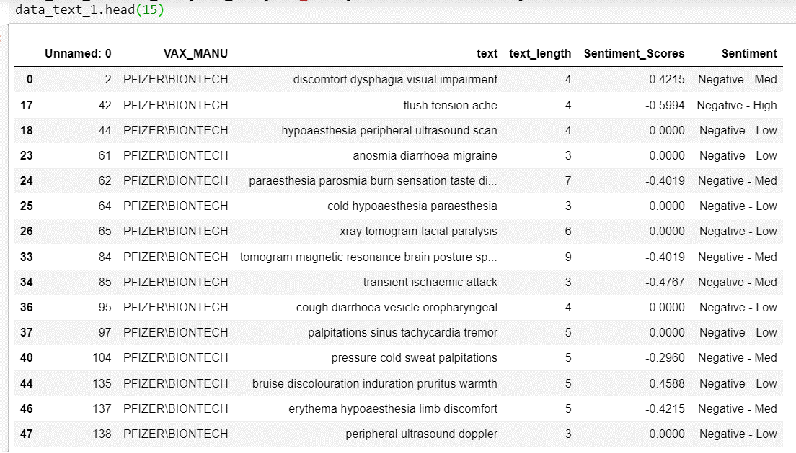
Sentiment Classification using Python

Slide 57
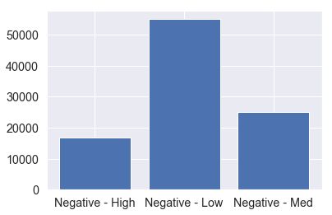
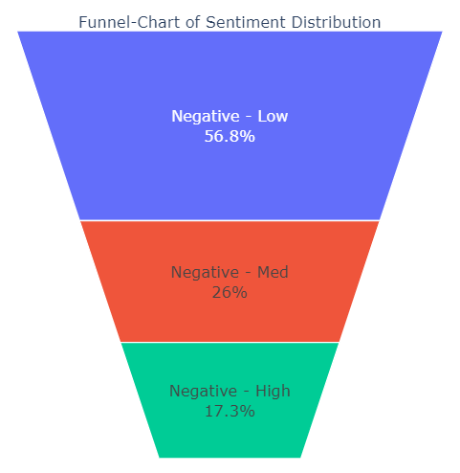
Sentiment Classification

Slide 58
Data Modelling- Descriptive Statistics

Slide 59
Distribution of Vaccine Lot Across the 3 Manufacturers
VAX_LOT | JANSSEN | MODERNA | PFIZER\BIONTECH
1 | 39,576 | 168,797 | 137,976
2 | 236 | 97,240 | 112,057
3 | 35 | 540 | 702
4 | 15 | 57 | 59
5 | 47 | 81 | 49
6 | 5 | 29 | 42
7+ | 16 | 195 | 22
UNK | 25,230 | 37,687 | 36,532

Slide 60
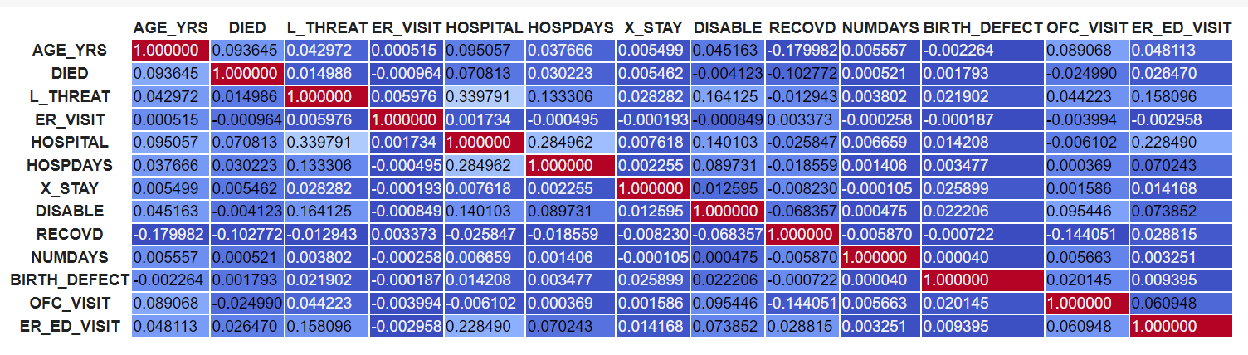
Cross Correlation across Variables

Slide 61
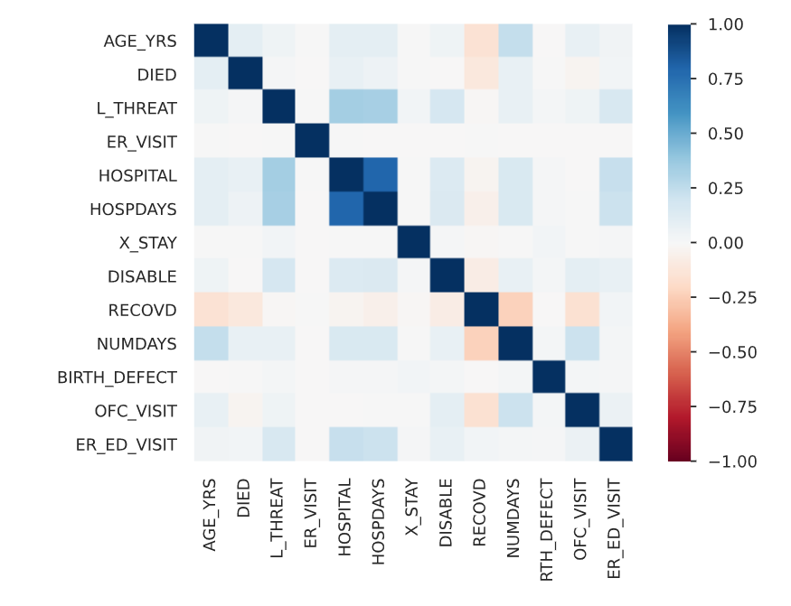
Cross Correlation across Variables (Visual)

Slide 62

Distribution based on Manufacturers – Average Hospital Days

Slide 63

Distribution based on Manufacturers – Average Age

Slide 64

Distribution based on Manufacturers – No of Deaths

Slide 65

Distribution based on Manufacturers – Average Age of Deaths

Slide 66

Distribution based on Gender – No of Deaths

Slide 67

Distribution based on Gender – Average Age

Slide 68

Distribution based on Genders - Average Days (Difference of Onset and Vaccine Dates)

Slide 69

Distribution based on Gender - Average Hospital Days

Slide 70

Distribution based on Deaths across States

Slide 71

Distribution based on Facility Vaccine Administered – No of Deaths

Slide 72
Machine Learning Model

Slide 73
Objective
Goal of the Study
Identify the Factors based on which the Mortality Rate depends
Build a DL Model for predicting the Mortality of a patient post vaccination
Methodology
Combining the 3 data files based on VAERS_ID, considering only COVID cases
EDA based on 3 Vaccines (Pfizer, Moderna & Janssen) and their subsequent side effects
Using DL Algorithms (LSTM), build a Classification Model for predicting effects of Vaccine across the 3 Manufacturers

Slide 74

Building the Classification Model – Step 1
Merging the 3 VAERS Dataset into One based on VAERS ID
Filtering Out Unknown Manufacturers and Non Covid related Data
Importing the 3 VAERS Dataset into the Python Environment based on 2021
Removing Irrelevant Columns (Symptoms Data which we can’t use in our Analysis)
Removing more Columns which aren’t adding value and have many classes
Removing the Date Columns

Slide 75
Building the Classification Model – Step 2
Treatment of Missing Values
Treatment of Missing Values
Descriptive Statistics
Defining the Dependent Variables – Death as Dependent Variable
Removing Duplicate Records
EDA _ Cross Correlation
Identifying the Independent Variables
Recoding String Variables into Binary Variables
Identify & Remove Multicollinearity Variables

Slide 76
Building the Classification Model – Step 3
Build Model using Train Data
Finalizing the LSTM Parameters
Test the Model
Build the Model using LSTM by defining the Parameters
Feature Selection
Splitting of Data
into Train & Test
Using Iterative Method to finalize the Parameters of the LSTM Model and check the Model Performance
Feature Scaling
Check the Predictability of the Model based on Test Data and fine-tune the Model if required

Slide 77
Data Modelling

Slide 78



VAERS Dataset – 3 Files

Slide 79

Data Preparation – Combined View

Slide 80


Data Preparation – Filtering, Imputing, Treating

Slide 81


EDA – Data distribution

Slide 82



EDA – Data distribution

Slide 83


EDA - Cross Correlation (Spearman’s & Cramer’s V(for Categorical))

Slide 84



Data Transformation - Creating dummy Variables for Categorical variables
Converted the Categorical variables into dichotomous variables based on their labels, and then included them in the Final Dataset and removed the original categorical variables

Slide 85


Feature Selection – Using Information Value

Slide 86

Feature Selection – Using WOE (Weight of Evidence) for taking care of Class Imbalance

Slide 87

Splitting of Dataset into 70:30 Split

Slide 88

Modelling – Logistic Regression

Slide 89

Modelling – Decision Tree

Slide 90

Modelling – Random Forest

Slide 91


Modelling – LSTM

Slide 92
Model Evaluation
Algorithms | Accuracy | AUC | Parameters
Logistic | 98.8 | 94.0 | Using Kfold with 5 Splits ( using c = 0.001, 0.01, 0.1,1,10,100)
Decision Tree | 98.8 | 92.4 | Using Kfold with Depth = 11
Random Forest | 98.8 | 91.7 | Trees = 250, Depth = 3,4,5,6
LSTM | 98.8 | 95.2 | Epochs = 120, Batch = 64, Drop out = 0.5

Slide 93
Appendix

Slide 94


VAERS Data

Slide 95

VAERS Vaccine

Slide 96


VAERS Symptoms

Slide 97


